Slide 1
Which Way Is Up
Mike Christensen, Ben Hansen, and Christine Kendall

Slide 2
Initial Problem
Robot used to in therapy for children with autism
Movement of robot linked to child's reaction
Hours of video
Time more important than movement

Slide 3
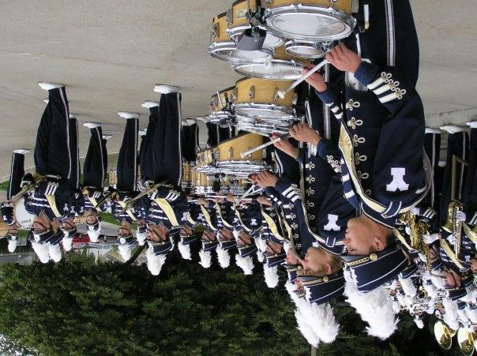
Problem Space
Importing photos from digital camera
Scanning photos on scanning bed
Auto-orient the photos
Output Class:
'left'
'down'
'right'
'up'

Slide 4
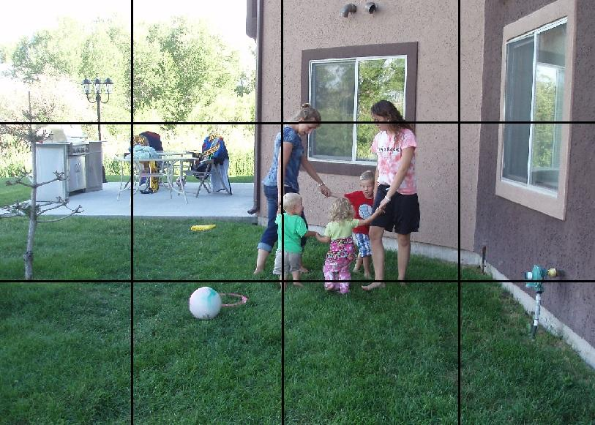

Features
Family Photos
1,616 photos (42% up% horizontal)
Ben and Christine's photos in training; Mike's in test
Divide the photo into rectangles
Determine average hue, saturation, and value

Slide 5
Initial Results
Baseline: 42%
MLP trained with Backprop
Learning Rate = 0.1
Momentum = 0
Hidden Layers = 1
Hidden Nodes = 20
Stopping criteria = 100 epochs with no improvement
Accuracy = 52%
Notes:
42 = % of test set up (accuracy we would get if guessed up every time)

Slide 6
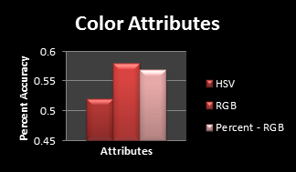
Feature Improvements
Shift from HSV to RGB
Notes:
hue wasn't continuous
averages
rgb = normalized to (0 -1) from value of red (0 -225)

Slide 7
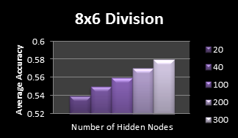
Feature Improvements
Number of Divisions (rows x columns)
1x1 = 42% (baseline)
4x3 = 58%
8x6 = 58%
16x12 = 56%

Slide 8
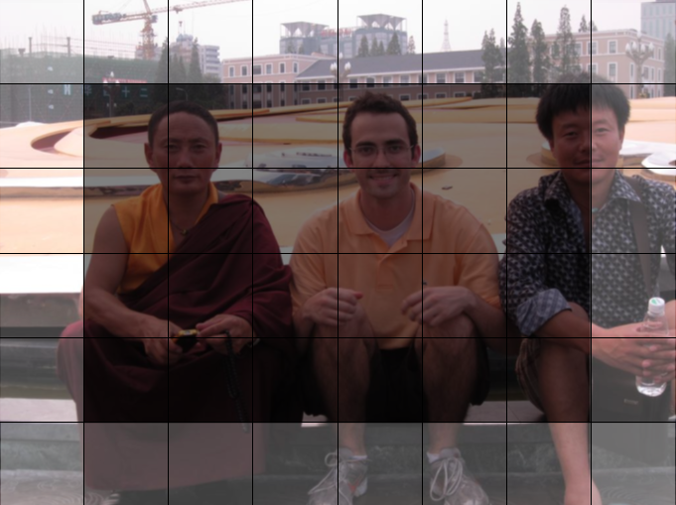
Border Rectangles
Only use regions making up each border.
RGB value used
8x6 = 58%
16x12 = 61%
Border pixel variance
Combination of:
Average red, green, blue color
Variance for each color
On full image
69% accuracy

Slide 9
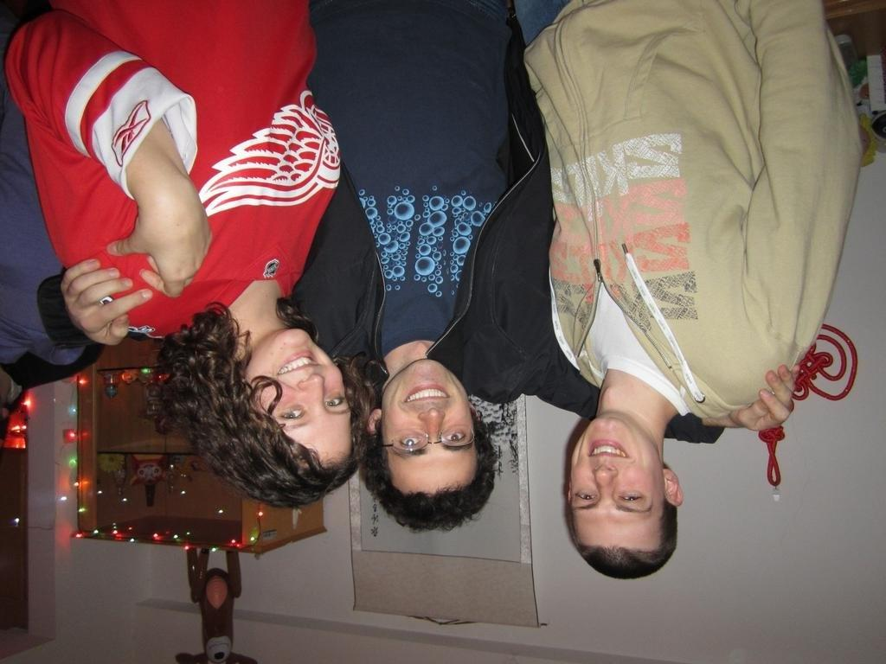
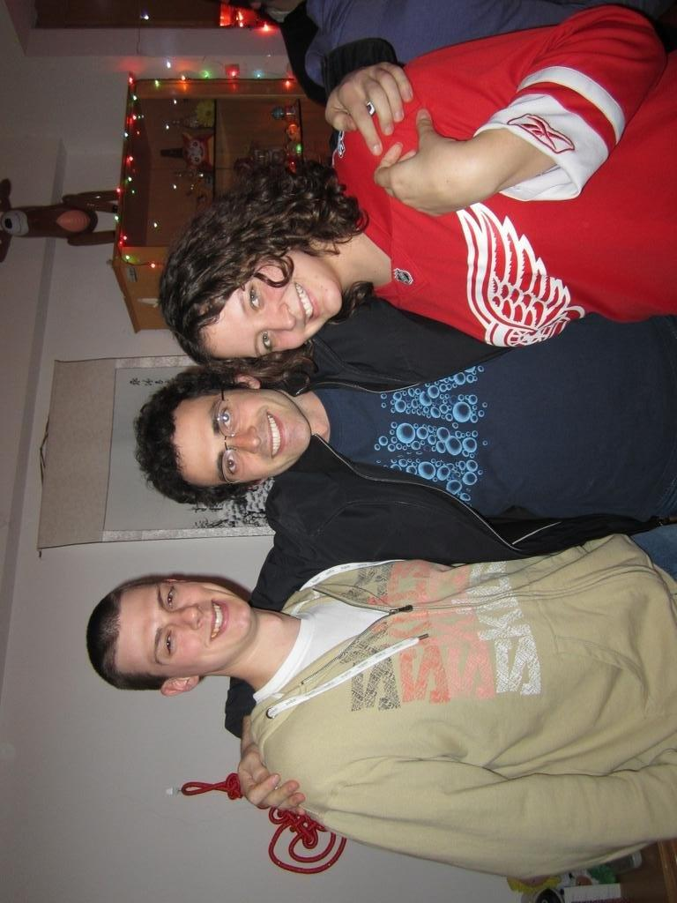
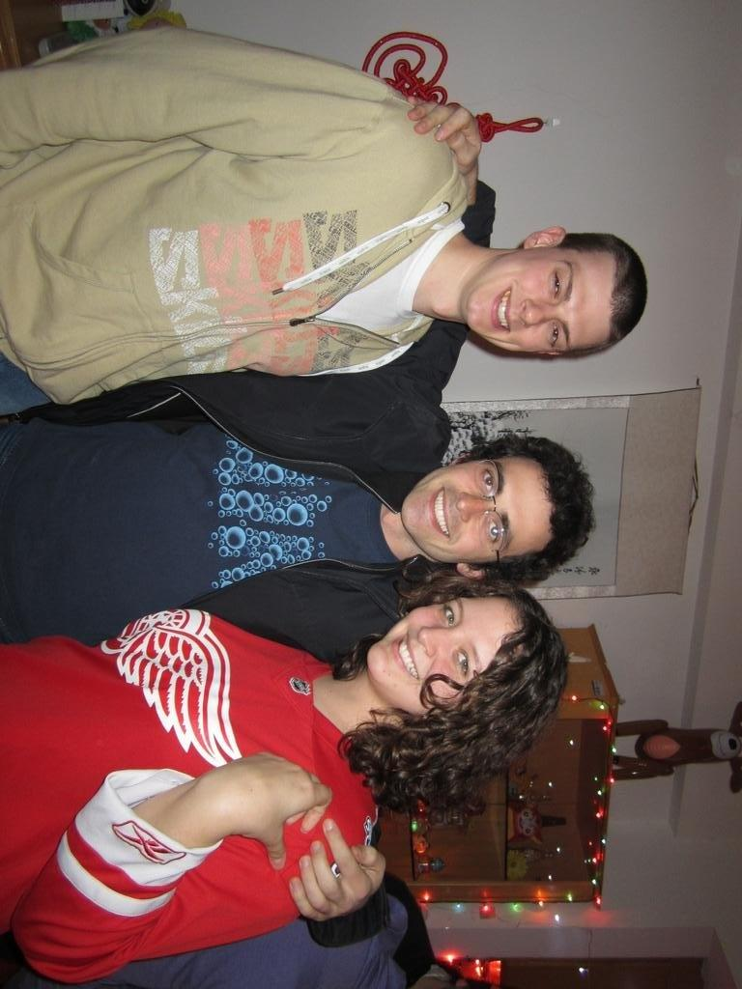
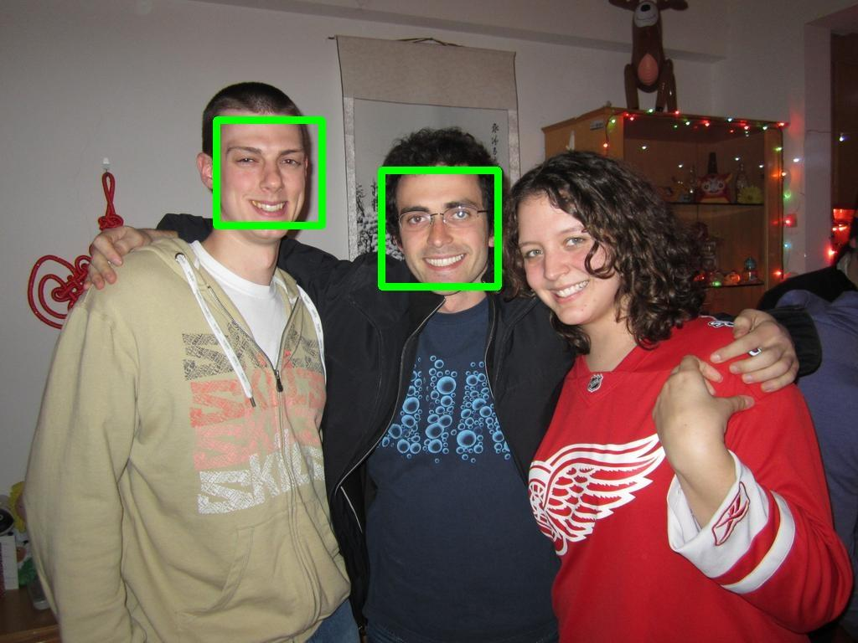
Face Detection
OpenCV Haar Cascade Classifier
Only detects faces directly facing camera
Input features are number of faces detected for each orientation
Accuracy = 68%
0
0
2
0

Slide 10
Final Results
For comparison:
Baseline: 42%
Initial MLP results: 52%
Ensemble of Face Detection and Border Average and Variance
Accuracy = 76%

Slide 11
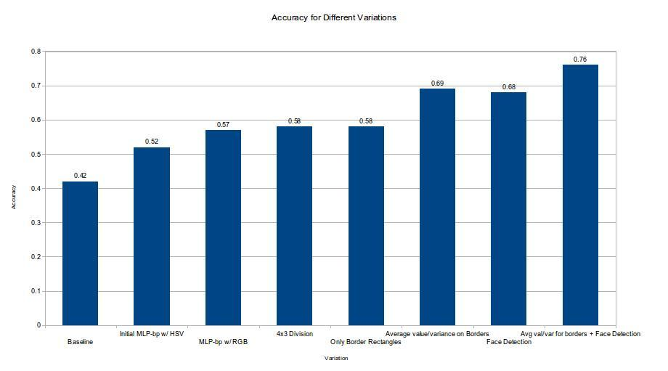
Conclusion

Slide 12
Future Work
Future Work
Add more data!
Detect more kinds of objects and detect them faster
Deep Neural Net from pixel values
Thank You!

